Slide 1
Live Intravital Intestine with Blood Flow Visualization in Neonatal Mice Using Two-photon Laser Scanning Microscopy
Yuhki Koike; Bo Li; Yong Chen; Niloofar Ganji; Mashriq Alganabi; Hiromu Miyake; Carol Lee; Alison Hock; Richard Wu; Keiichi Uchida; Mikihiro Inoue; Paul Delgado-Olguin; Agostino Pierro
“Introduce introduce introduce introduce introduce introduce introduce introduce introduce introduce”

Slide 2
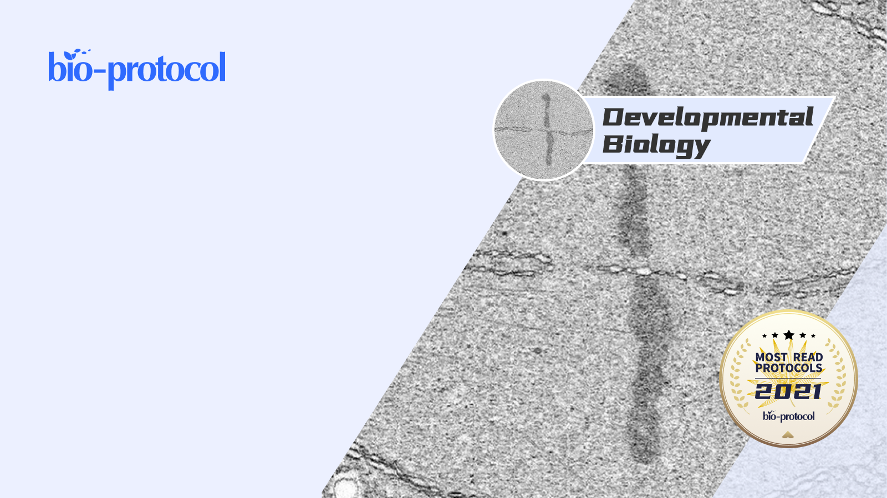
Live Intravital Intestine with Blood Flow Visualization in Neonatal Mice Using Two-photon Laser Scanning Microscopy
Yuhki Koike; Bo Li; Yong Chen; Niloofar Ganji; Mashriq Alganabi; Hiromu Miyake; Carol Lee; Alison Hock; Richard Wu; Keiichi Uchida; Mikihiro Inoue; Paul Delgado-Olguin; Agostino Pierro

